Slide 1
Project Proposal Presentation
Birat Kshitiz College, Biratnagar
Presenters
Bibas Basnet
Bonas Paudel
October,3 2023
BCA 4th semester, Batch 2077

Slide 2
01
INTRODUCTION
02
OBJECTIVES
03
PROBLEM STATEMENT
Agenda
04
USE-CASE DIAGRAM
05
TOOLS & TECHNOLOGY
06
METHODOLOGY
07
CONCLUSION
08
SOME DESIGNS

Slide 3


HALCYON for electronic items
Provide detailed product information
Allows customers to order and pay online
Designed to enhance customer shopping experience
Customer support features: phone, email, live chat, FAQ

Slide 4

Provide detailed product information, including company name, model number, color, dimension, and price.
Provide information about delivery and payment methods.
Minimize time and effort for customers to get electronic products.
Provide all required details about electronic products.

Slide 5

PROBLEM STATEMENT
Lack of knowledge about electronic devices
Time-consuming and costly to go to the shop
Disruptive to work

Slide 6
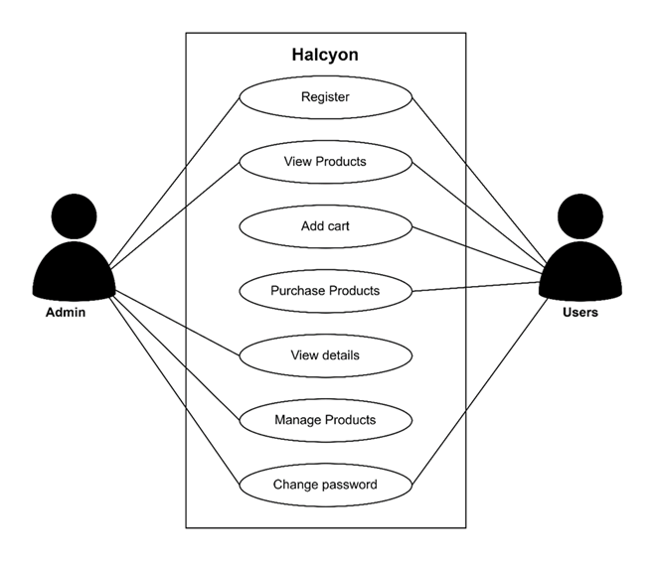
USE-CASE DIAGRAM

Slide 7

TOOLS AND TECHNOLOGY
Frontend
HTML
CSS
JavaScript
Backend
MySQL
PHP

Slide 8
METHODOLOGY
The methodology of this project is fully based on the agile model
  Planning
  Requirements
  Design
  Coding
Testing
Development
Review

Slide 9
CONCLUSION
Halcyon is an e-commerce website that can save your time and money.
It offers a wide selection of products delivered to your doorstep.
Halcyon is essential for enhancing your lifestyle, increasing your work productivity, and staying technologically ahead.
It is simple and efficient to use with a high-level user interface.

Slide 10
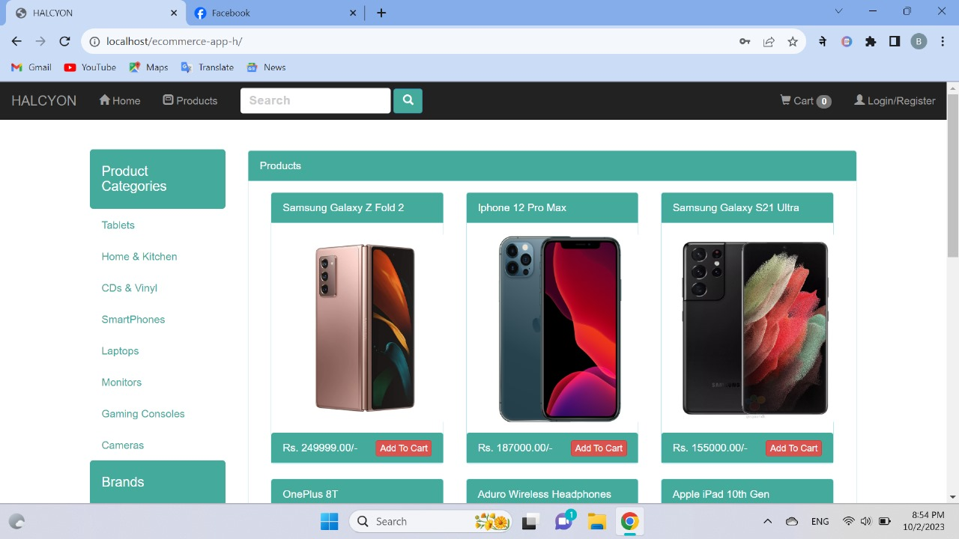
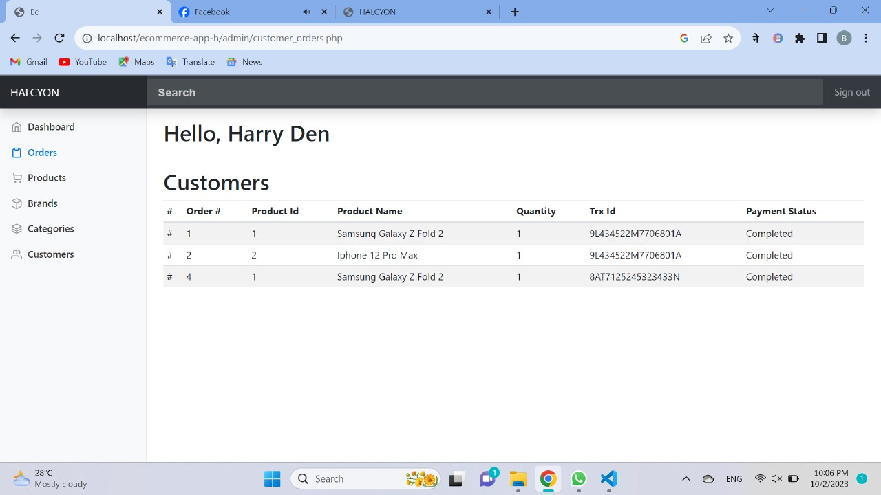
SOME DESIGNS

